Slide 1
Flood MONITORING AND EARLY WARNING SYSTEM

Slide 2
ABSTRACT
Flooding is one of the major disasters occurring in various parts of the world.To reduce the effect of the disaster, a flood warning and monitoring are needed to give an early warning to the victims at certain place with high prone to flood. By implementing Internet of Thing technology into the system, it could help the victim to get an accurate status of flood in real-time condition.

Slide 3
Introduction
The flood warning system utilizes computer technology, database technology, communication technology, and sensor technology. Powered by IoT technology, rainfall and water levels are monitored and floods are predicted. Early warning of impending flooding can save lives and reduce extensive property damage.

Slide 4
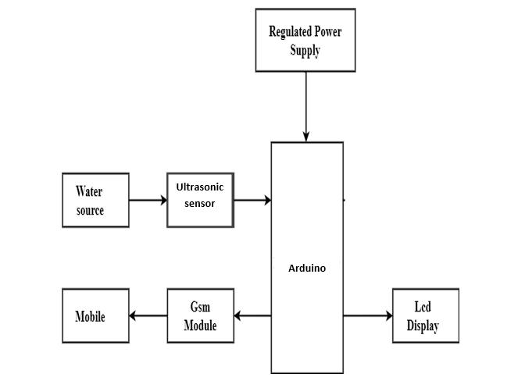
Design

Slide 5
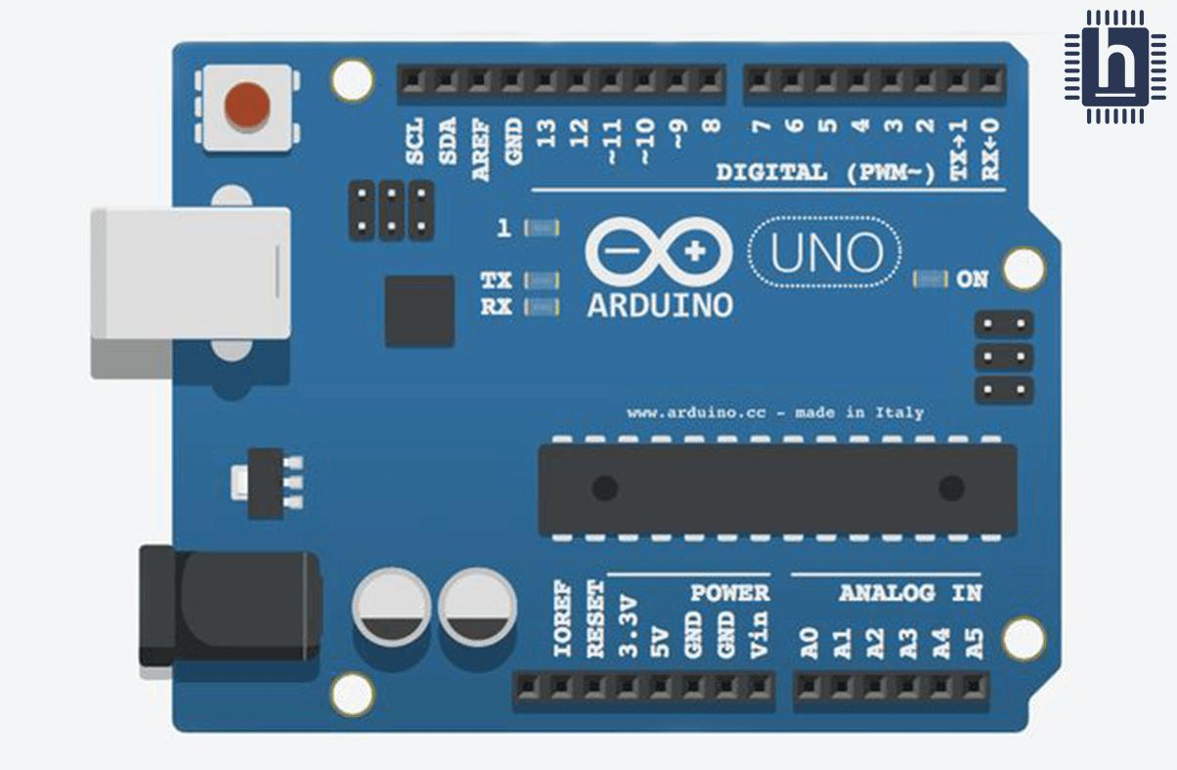
Hardware components
Arduino UNO
Arduino UNO is a low-cost, flexible, and easy-to-use programmable open-source microcontroller board that can be integrated into a variety of electronic projects. This board can be interfaced with other Arduino boards, Arduino shields, Raspberry Pi boards and can control relays, LEDs, servos, and motors as an output.
Arduino UNO

Slide 6
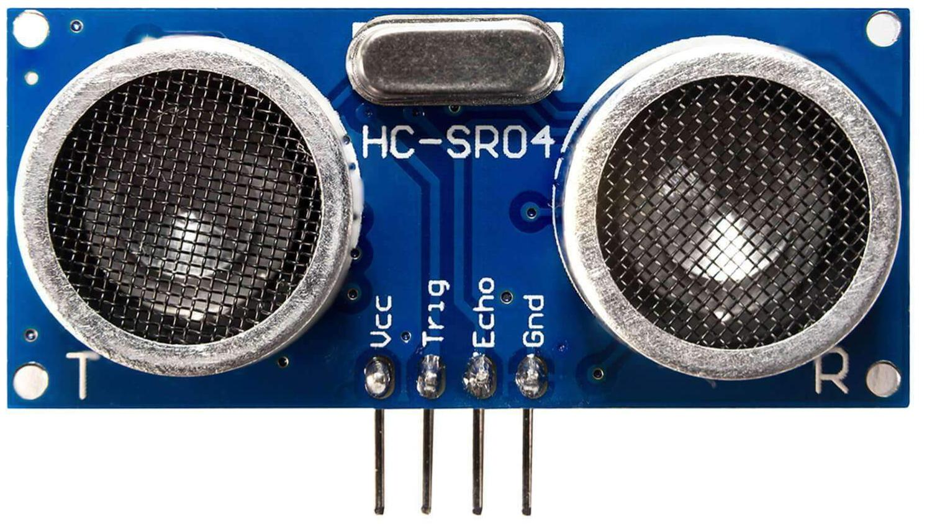
Ultrasonic sensor
Ultrasonic sensor are used As they utilise high frequency soundwaves To calculate the distance to a remote object without physically touching it, they can be used to create systems that reliably determine wave height and water levels at much lower installation and maintenance costs.

Slide 7
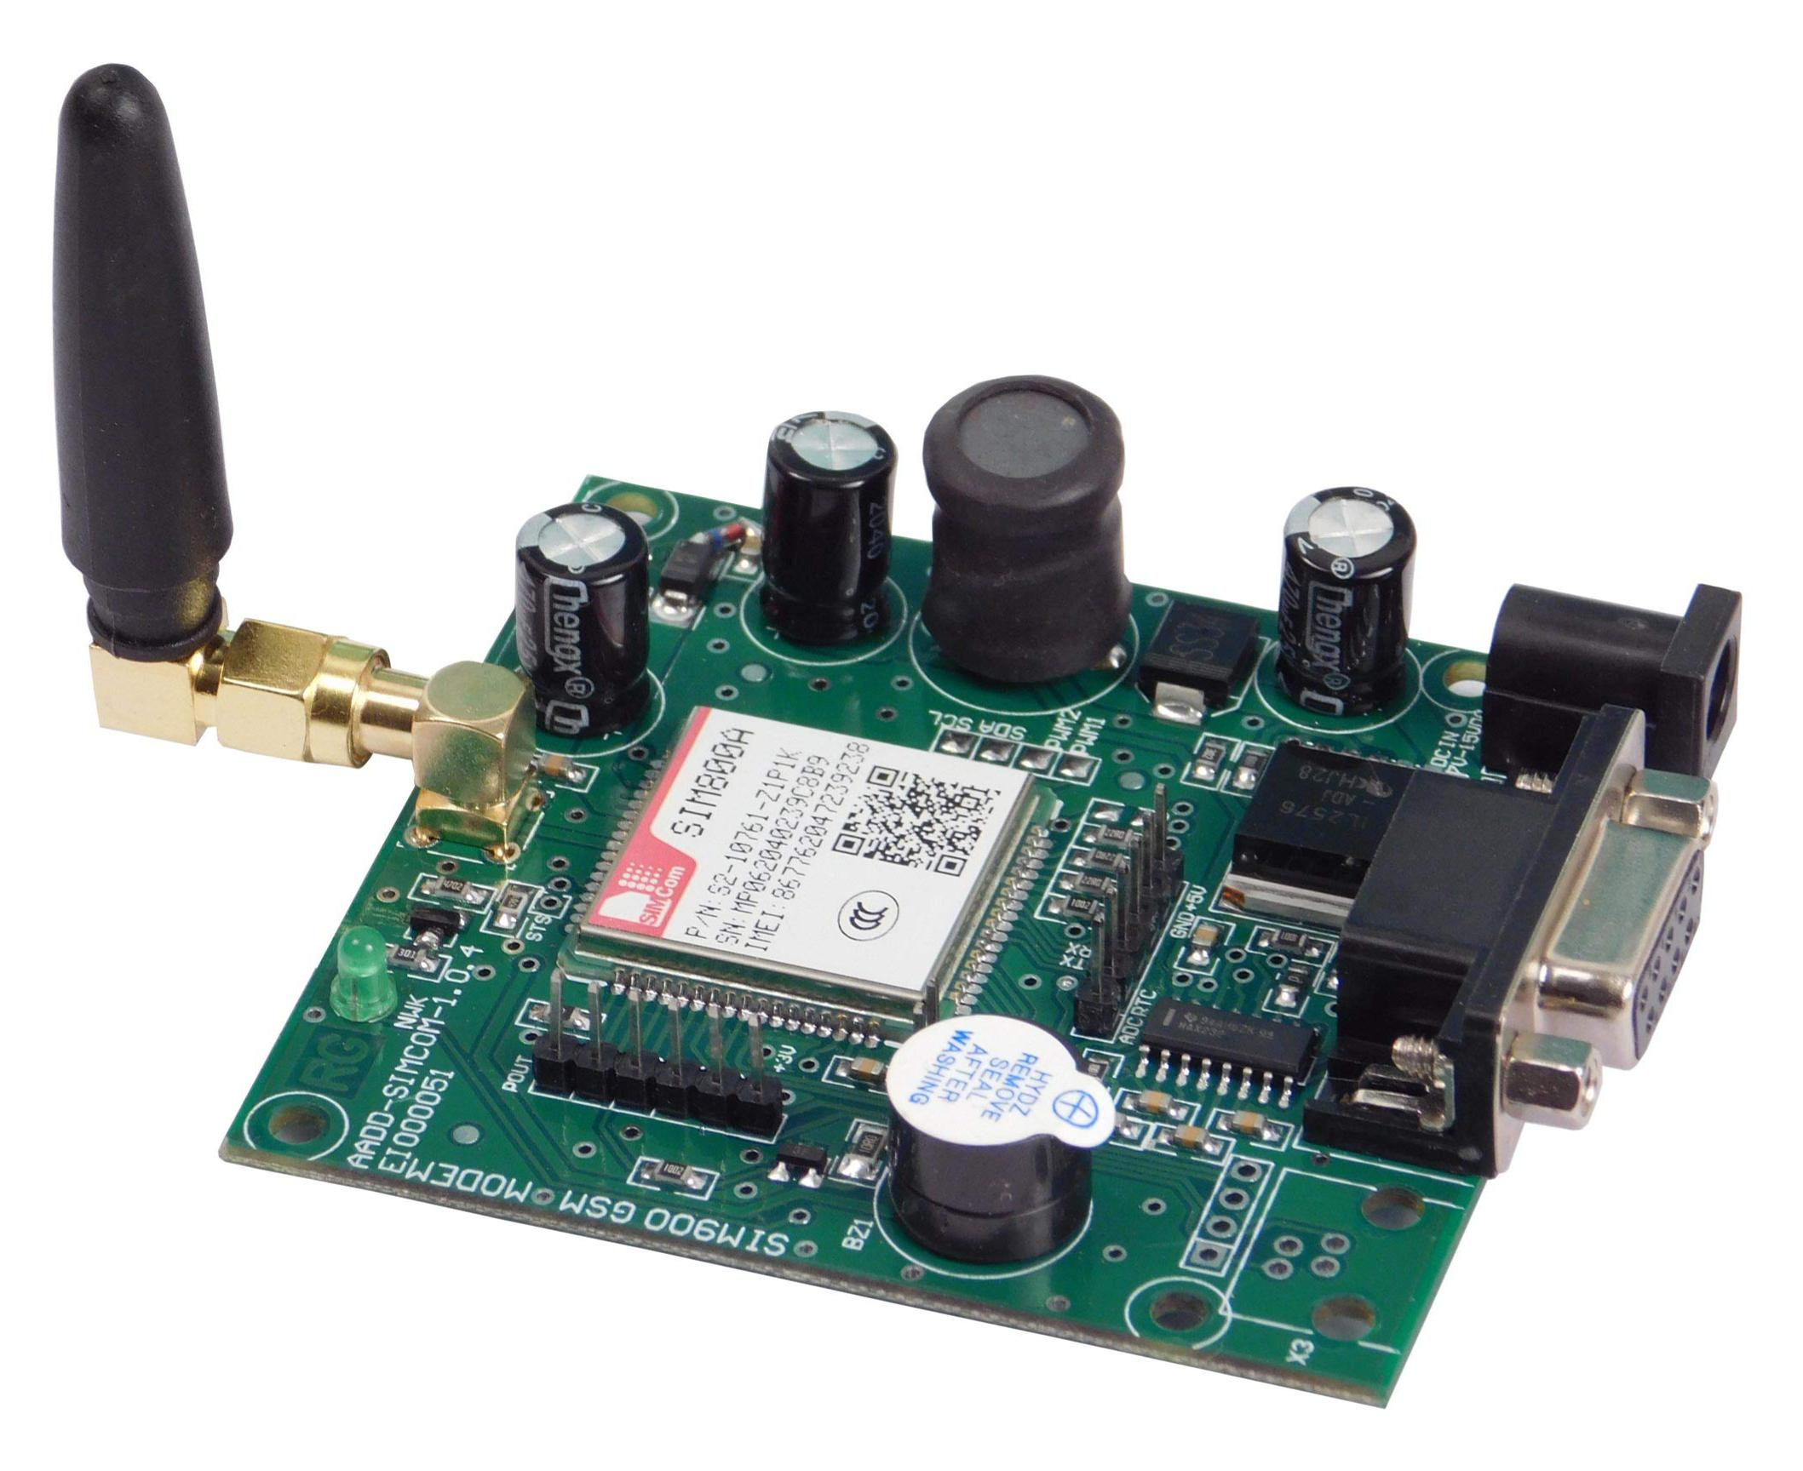
Gsm
Gsm stands for Global system for Mobile communication.The GSM module plays a crucial role in the communication between devices and the GSM network. It is responsible for establishing and maintaining the communication link between the device and the network. The module also handles the encryption and decryption of data, which ensures the security of the communication.

Slide 8
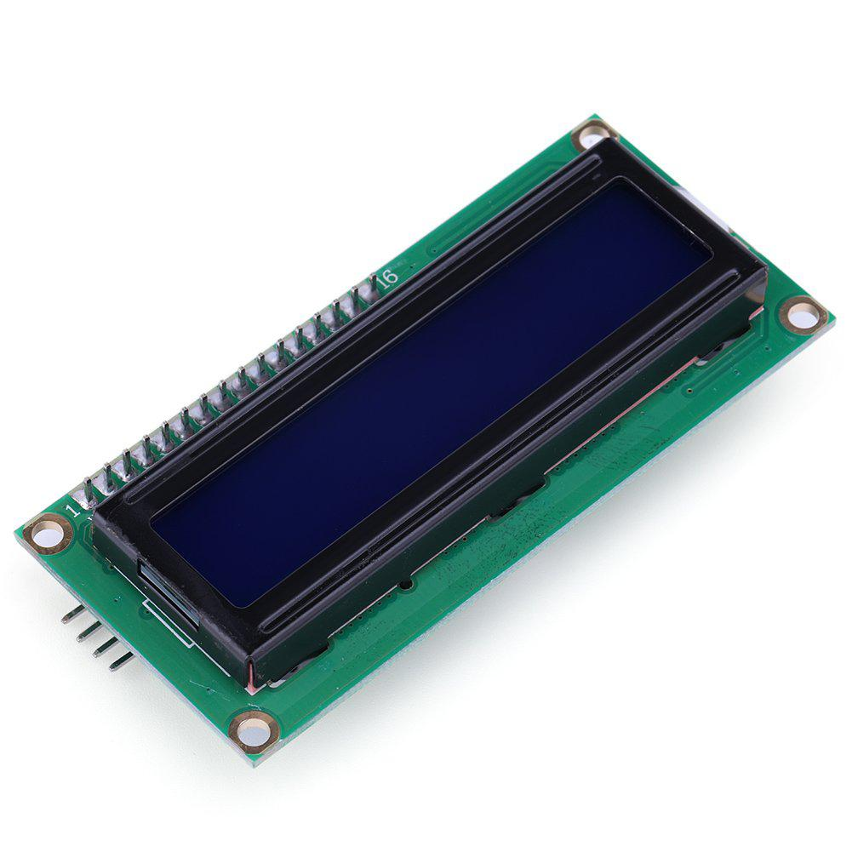
Lcd display
Lcd stands for liquid crystal display.The LCD display can be connected to the Arduino using a parallel bus, when there are available ports, or a serial bus, using the I2C module

Slide 9
Conclusion
As the project is enabled with IOT technology and hence the sensor data can be monitored from anywhere in the world. More sensors can be integrated into the system in order to create more accurate and efficient flood detection system.

Slide 10
Thank you

